Slide 1
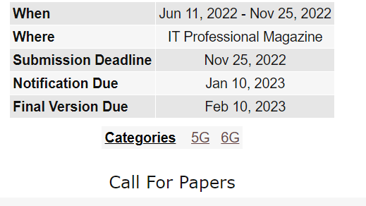
xG Impact on IT and Systems 2022 : xG Impact on Information Technology and Systems
https://www.computer.org/digital-library/magazine/it/cfp-info-tech-systems

